Slide 1
Using Turnstile Data To Forecast Student Worker Staffing
Chad Madding
Shane Weinstock

Slide 2


Our Team
Shane Weinstock
Chad Madding
Notes:
On behalf of my partner and myself, Chad Madding I would like to thank you for being here today.

Slide 3
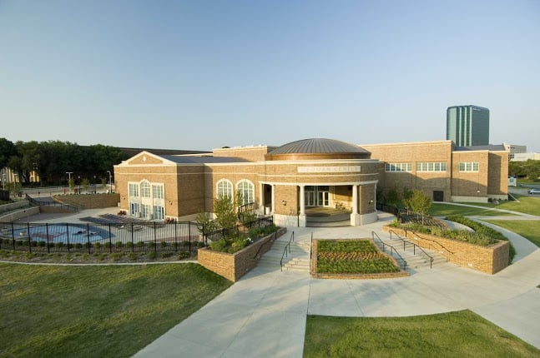
Clients and Directive
Clients: This report is being prepared for the management of the Dedman Center for Lifetime Sports at Southern Methodist University.
Directive: We have been tasked with providing general usage of the facilities in the form of entry data. The main goal will be to use ID swipes as a response variable to assist in hiring patters for the facilities’ student staff. It is the goal of the report to assist in the spotting of trends and thus correctly identify staffing needs. Forecasting and general knowledge about building usage will also assist with budgeting needs.
Notes:
This report is being prepared for the management of the Dedman Center for Lifetime Sports at Southern Methodist University.
We have been tasked with providing general usage of the facilities in the form of entry data. The main goal will be to use ID swipes as a response variable to assist in hiring patters for the facilities’ student staff. It is the goal of the report to assist in the spotting of trends and thus correctly identify staffing needs. Forecasting and general knowledge about building usage will also assist with budgeting needs.

Slide 4
The Data
Data: The data provided to us has been collected from three turnstiles at the Dedman Center for Lifetime Sports on the campus of Southern Methodist University.
The data was provided to us by the University
It measures the activity of Dedman by ID card swipes through turnstiles
The data utilized are entries from Jan 2019 through March, 11 2020 (present day).
We will be converting the data to daily usage numbers to assist in forecasting future usage of the facility and attempt to assess demand and staffing needs.
Through the data collected, we will assess correlated values and seasonal aspects of the facilities usage.
Notes:
The data provided to us has been collected from three turnstiles at the Dedman Center for Lifetime Sports on the campus of Southern Methodist University. The data set is a record of the time of swipe, the turnstile used, and an anonymized student ID number. The data was collected from January 2nd, 2019 through March 11th, 2020, and consists of 414,156 entries. Entry and error swipes are included in the data. It should be noted that the turnstiles are only used to enter the facility, and no swipe is required to exit the building. We have also collected hourly weather data from NOAA for the same period to assist in forecasting.

Slide 5
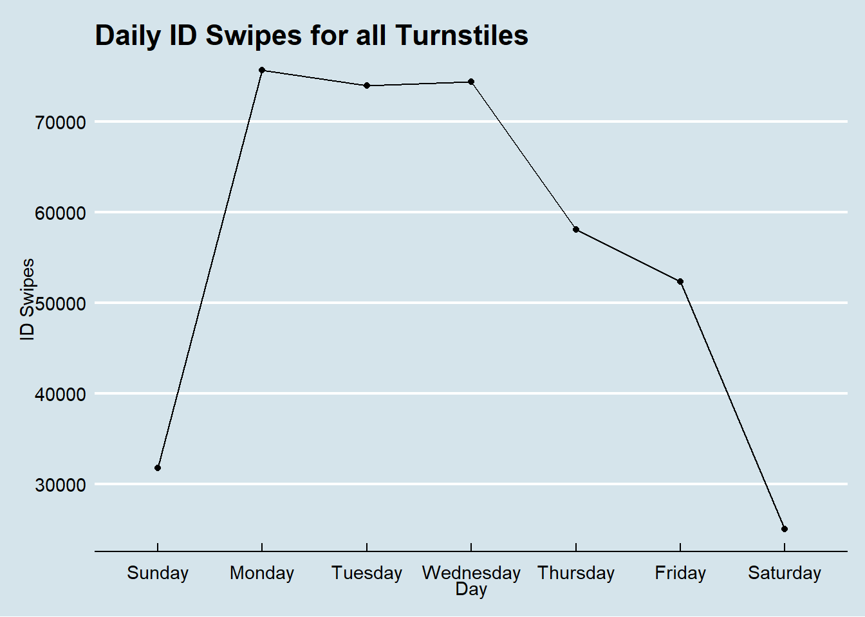
Building Usage
Daily Totals: In helping access the staffing needs we wanted to get a snapshot of the general usage of the facilities.
Top Days:
Monday
Tuesday
Wednesday
Notes:
In helping access the staffing needs we wanted to get a snapshot of the general usage of the facilities. Monday, Tuesday and Wednesday had the highest entries

Slide 6
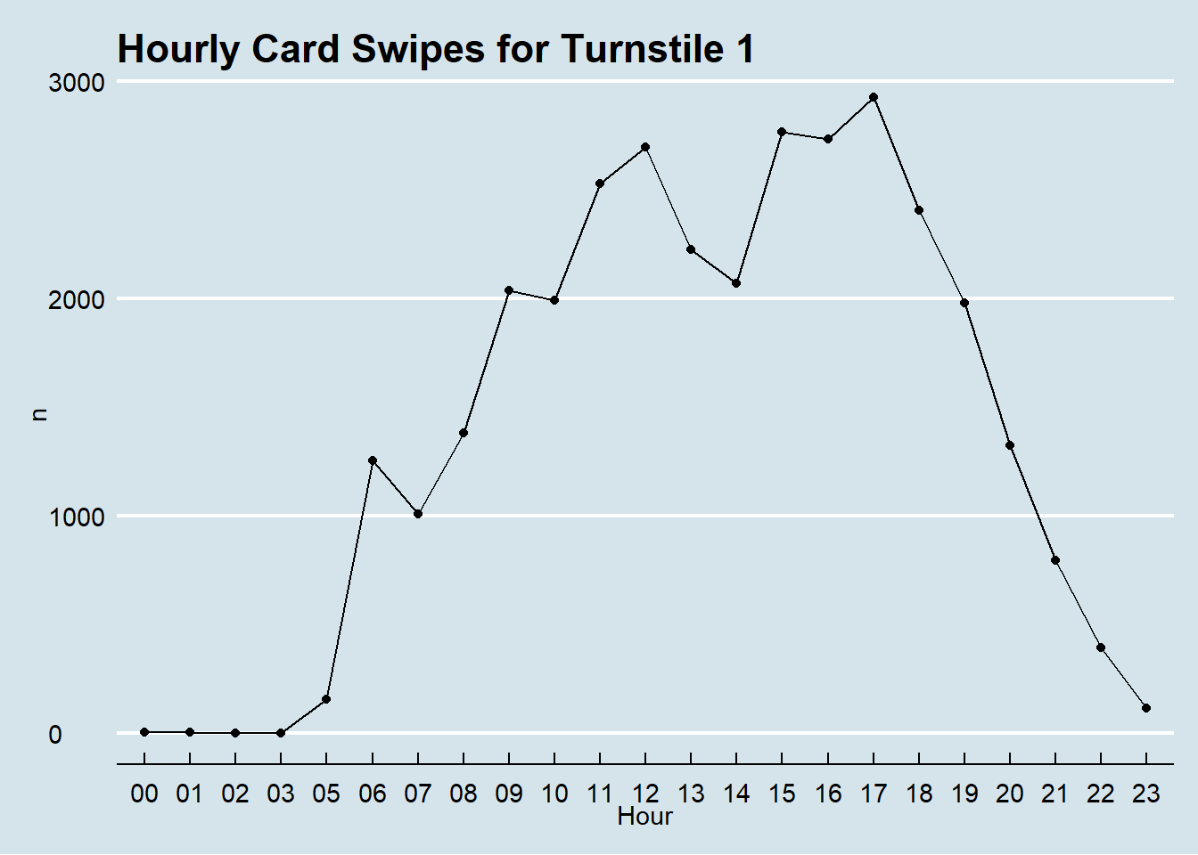
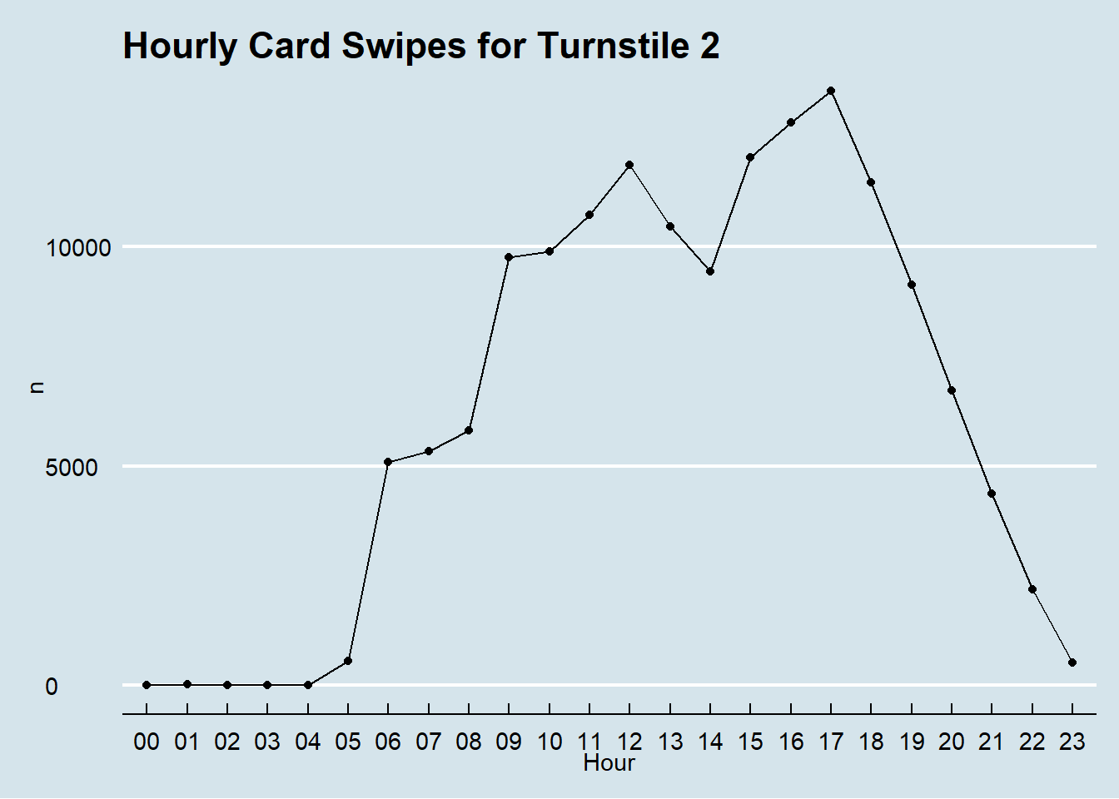
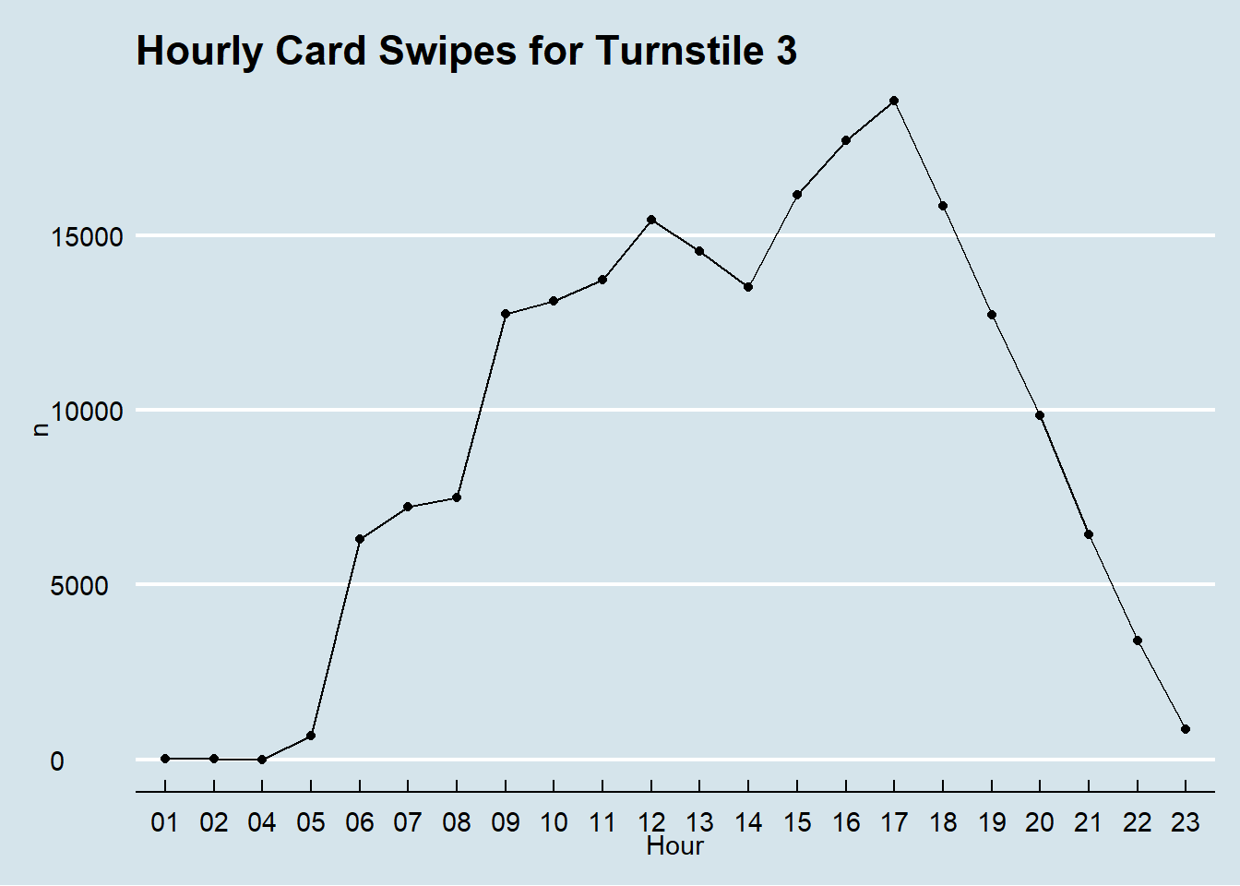
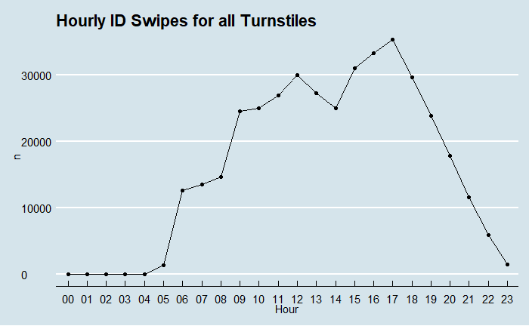
Building Usage
Hourly Totals
Turnstile three is used considerably more but all seem to have the same pattern.
Peek times: Noon & 6 PM
Notes:
Turnstile three is used considerably more but all seem to have the same pattern. Peek times seem to hit at noon and 6 PM

Slide 7
Building Usage
User Totals: For the 14 months
Top 10 Users*
*Anonymized ID Numbers
Induvial ID’s Swipe Breakdown
ID# Total
1445 429
1168 413
1429 390
1469 369
1140 361
912 354
1778 349
104 339
152 338
214 335
Min. 1st Qu. Median Mean 3rd Qu. Max.
1.00 7.00 21.00 35.99 48.00 429.00
Total Individual ID’s used:
10,873
Notes:
The user data is anonymized but we can still see who are some of the top users. This also show that on average a person will use the building about 36 times within a range of 7 to 48. The top ten members use the facility over 330 times with the top coming in at 429. The total individuals swiping into the facility is at 10,873.

Slide 8
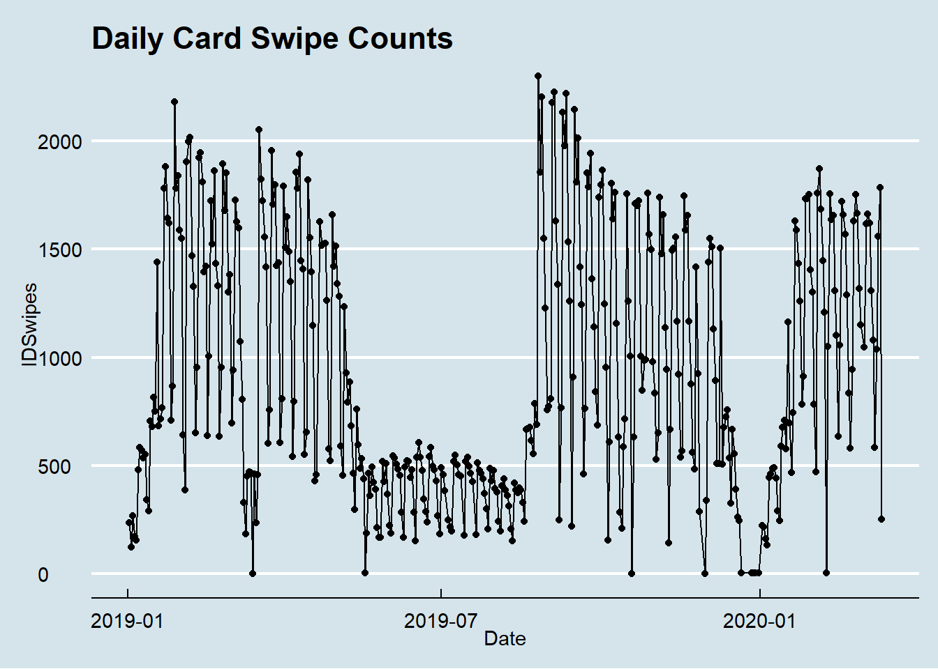
Stationary / Non-Stationary
Does the mean depend on time?
rolling mean = 934
data set mean = 929
Notes:
The first step in time series analysis is to check for stationarity, because if the data is stationary, then many simplifying assumptions can be made.
The most important property of a stationary process is that the autocorrelation function (ACF) depends on lag alone and does not change with the time at which the function was calculated.
Pure stationary data will generally only appear in educational situations and is not generally seen in real-world situations, so for a more practical since we will be looking for at least A weak stationary process that at least meets the conditions of a constant mean and ACF (and therefore variance).
1. The Dedman information is 13 and a half months of data, and there is no firm evidence of a strong seasonal component to the series. There does appear to be a dip in traffic during the Summer of 2019 and others during brakes. Overall, there does not appear to be strong evidence that the mean is changing with time. We found the weekly rolling mean to be 934 almost equal to the data set's mean of 929—one more bit of information pointing to the mean not being dependent on time.

Slide 9
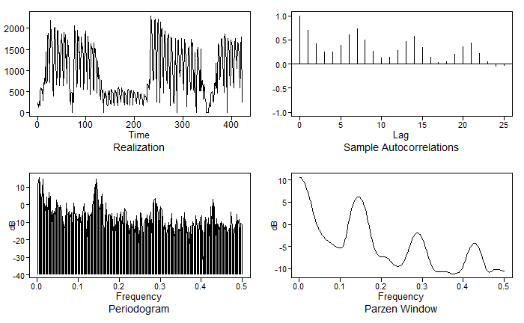
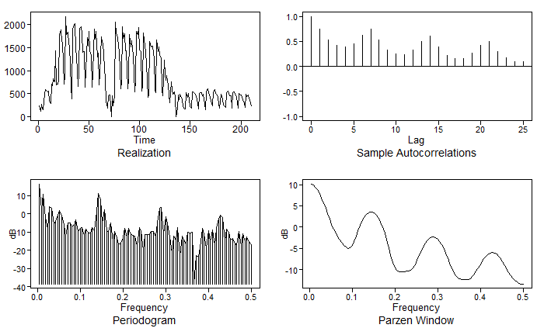
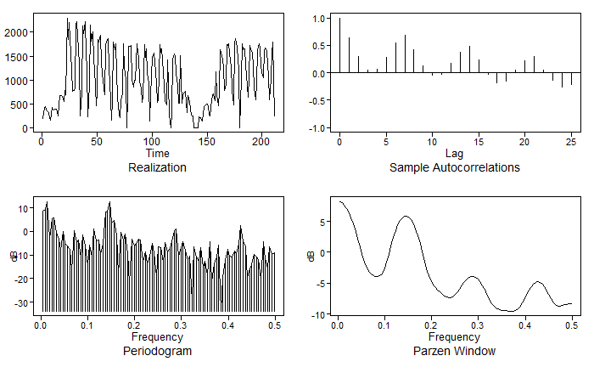
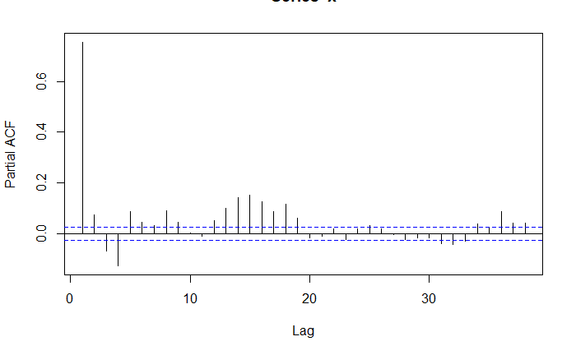
Stationary / Non-Stationary
Entire Data
First Half
Second Half
In the above plots we can observe the following conditions:
The mean does not depend on time
The variance does not depend on time
The covariance depends only on how far apart in time observations are rather than where in time they are.
From these plots we can assume that most conditions have been met for stationarity.
Notes:
2. There is some evidence that the variance changes slightly at times, but the evidence does not seem to be strong enough to reject the possibility that the time series is stationary based on the second condition.
3. When we look at the first and second halves of the ACF for this realization, the correlation structure appears to be very similar. This would mean that the correlation between points only depends on how far apart the points are and not where they are, which gives evidence to support a stationary data set.
Finally, we can look at the sharp drop after lag one in the PACF. This shows that, though a bit weak, the Dedman data set is assumed to be "close enough" to stationarity. There does seem to be a bit of seasonality in the data being that it follows a general pattern of campus life (students are not there in the Summer). We will address this in the modeling of the data.

